Slide 1

IoT Alliance Australia Inaugural State of the Nation Workshop
6 September 2016

Slide 2
Welcome & Introduction
Cover design 1
Chris McLaren KPMG

Slide 3
Today
3.00pm | Welcome & Introduction | Chris McLaren - Partner, KPMG
3.10pm | Government Perspectives | Senator the Hon. Mitch Fifield Minister for the Arts Minister for Communications
3.25pm | Barangaroo Community IoT Gateway Switch-On | Senator the Hon. Mitch Fifield Minister for the Arts Minister for Communications
3.30pm | State of the Nation: How Australia is performing vs Global-Leading Nations | Hugh Ujhazy - IDC Frank Zeichner - CreatorTech
3.50pm | IoTAA Industry Progress: Panel Session of Workstream Chairs | Moderator: John Stanton Chair, IoTAA Executive Council
4.20pm | Consumer Perspectives | Teresa Corbin - CEO, ACCAN
4.30pm | Smart Industries & Cities: Panel of Sectoral representatives | Moderator: Catherine Caruana-McManus Founder, Giant Ideas
5.00pm | Hypercat Update | Justin Anderson - Founder, Hypercat Piers Hogarth-Scott - National IoT Leader, KPMG
5.20pm | Closing Remarks | Dr Mike Briers, AO - UTS
5.30pm | Drinks & Networking | Connect Space, Level 26

Slide 4

IoT Alliance Australia

Slide 5
IoTAA – A Bias For Action
265 participants from 125 organisations
IoTAA
Executive Council
Chair: John Stanton (Communications Alliance)
IoTAA Coordination
Workstream 1
Collaborative AUS IoT Industry
Workstream 2
Smart Industries & Cities
Workstream 3
Open Data & Privacy
Workstream 4
Spectrum Availability & Licencing
Workstream 5
Security & Network Resilience
Workstream 6
Start-up Community
Chair: Chris McLaren (KPMG)
Develop a coherent, collaborative and globally-aware Australian IoT community with industry, Government and other key stakeholders to foster innovation and inform appropriate policy and regulatory settings.
Chair: Catherine Caruana-McManus (Giant Ideas)
Develop sectoral IoT advancement and alignment with key sectors, including through Government Industry Growth Centre activities, Infrastructure Australia, state Governments and key sectoral bodies with an initial focus on water and energy resource management, food and agribusiness, transport, and Smart Cities.
Chair: Peter Leonard (Gilbert + Tobin)
Develop IoT open data and data sharing principles and guidelines with a possible sectoral focus. In conjunction, develop data privacy guidelines for use of IoT data.
Chair: Nevio Marinelli (ACMA)
Develop spectrum-related knowledge and settings to maximise IoT opportunities in Australia and work with industry and Government to seek to ensure optimum spectrum arrangements and licensing frameworks are in place.
Chair: Malcolm Shore
Develop security guidelines for IoT services and service elements, including data protection.
Chair: Stuart Waite (Timpani)
Develop policy and IoT eco-system frameworks in support of a national IoT program supporting the start-up community, which is linked to Industry Growth Centres.

Slide 6
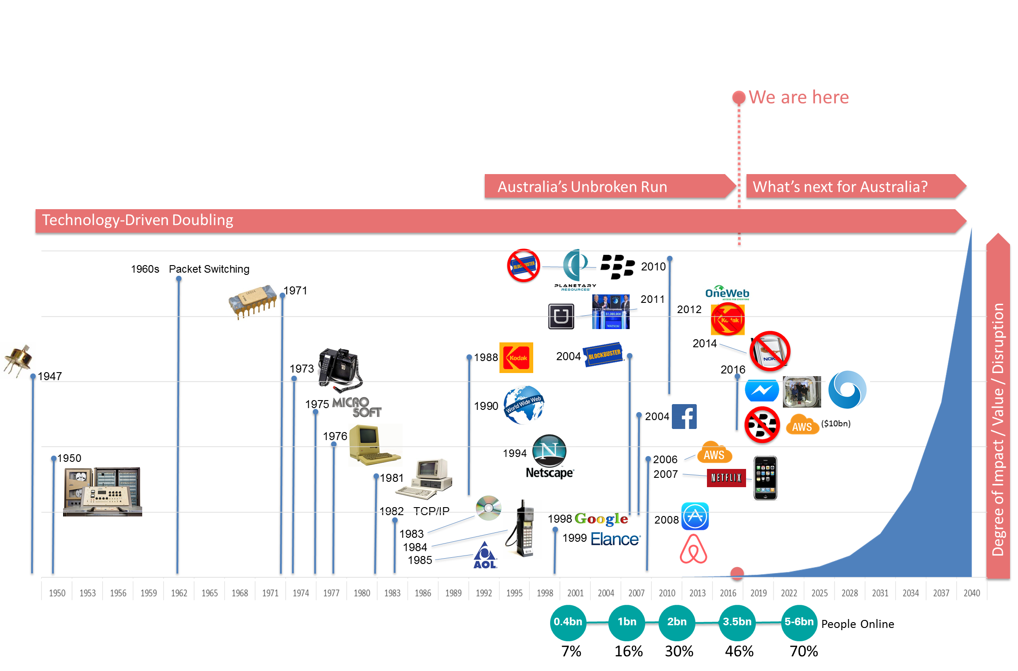
IoTAA – A Call to Action

Slide 7
Senator the Hon Mitch Fifield Minister for the Arts Minister for Communications
Cover design 1

Slide 8
State of the Nation: How Australia is Performing vs Global-Leading Nations
Cover design 1
Hugh Ujhazy IDC
Frank Zeichner Creator Tech

Slide 9

Australia : The State of IOT

Slide 10

Little or no monetary or business value is achieved
LOB leaders are pressured by customers and competitors to accelerate IOT rollout
Initial outcomes are realised but defining concrete ROI is challenging
IOT solution impact capex and opex, bringing early transformation
IOT functions as major influencer and key driver of digital transformation
IOT Disruptor
Most Australian enterprises are here
IOT Strategist
IOT Connecter
IOT Explorer
IOT Experimenter
Ad hoc
Opportunistic
Repeatable
Managed
Optimised
IoT is a journey…

Slide 11
Operational Excellence
Top 5 APeJ IoT Use Cases
Manufacturing Ops
Freight Monitoring
Production Asset Mgmt
Smart Grids
Smart Buildings
Top 5 APeJ IoT Use Cases
12%
of APeJ enterprises will see IoT as an opportunity for revenue generation in 2016
Source: IDC WW IoT Survey, Sep 2015: AP=840; IDC Internet of Things Spending Guide, 2016

Slide 12
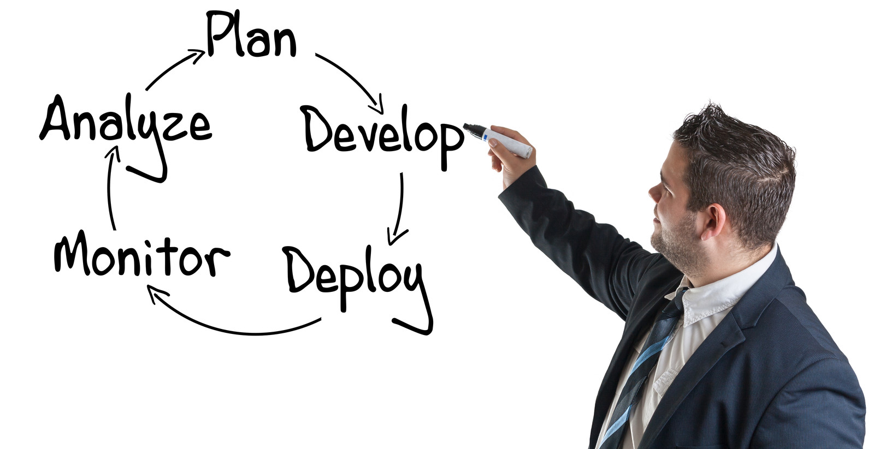
IOT Lifecycle
32% of respondents in Australia plan to deploy security solutions, followed by 28% considering payment solutions.
Source: IDC WW IoT Survey, Sep 2015: AP=840; IDC Internet of Things Spending Guide, 2016

Slide 13
32% of respondents in Australia plan to deploy security solutions, following by 28% considering payment solutions.
IOT Lifecycle
64% of respondents in Australia have deployed IOT solutions, with 25% planning to extend existing solutions.
Source: IDC WW IoT Survey, Sep 2015: AP=840; IDC Internet of Things Spending Guide, 2016

Slide 14
32% of respondents in Australia plan to deploy security solutions, following by 28% considering payment solutions.
IOT Lifecycle
54% nominated internal IT as major IOT decision maker with further 30% nominating internal line of business.
Source: IDC WW IoT Survey, Sep 2015: AP=840; IDC Internet of Things Spending Guide, 2016

Slide 15
IoT Spending Guide Use Cases & Industry Splits
Banking
Government
Healthcare
Resource Industries
Transportation
ATM Remote Tracking
Other Banking Use Cases
Intelligent Transport System: Automated Public Transport
Intelligent Transport System: Parking Mgmt
Intelligent Transport System: Traffic Mgmt including tolling & congestion
Intelligent Transport System: Traveler Information Systems
Environmental Monitoring Detection
Public Infrastructure Asset Management
Public Safety & Emergency Response
Other Gov’t. Use Cases
Telehealth Systems
Clinical Care
Hospital Asset Tracking
Remote Health Monitoring
Other Healthcare Use Cases
Agriculture Animal Tracking
Connected Oil Field Exploration
Other Resource Industry Use Cases
Air Traffic Monitoring: Tower Control
Air Traffic Monitoring: Airplane GPS (ADS-B)
Freight Monitoring
Asset/Fleet Management
Other Transportation Use Cases
Construction
Construction Machinery Mgmt
Other Construction Use Cases
Insurance
Retail
Insurance Telematics
Other Insurance Use Cases
Connected Vending Machines
Digital Signage
Omni-channel Operations
NFC Payment/Shopping
In-Store Consumer Digital Offers/ Personalized Promotions
Other Retail Use Cases
Cross Industry
Utilities
Staff Identification
Smart Buildings: Infrastructure
Smart Buildings: Lighting
Connected Vehicles: Infotainment
Connected Vehicles: Security
Connected Vehicles: Emergency
Connected Vehicles: V2V/V2I Advanced Solutions
Cross Industry Use Cases
Manufacturing
Smart Grid Electricity: Smart Meters
Smart Grid Electricity: Distribution Automation
Smart Grid Gas: Smart Meters
Smart Grid Gas: Distribution Automation
Other Utilities Use Cases
Connected Vehicles
Food Traceability
Maintenance & Field Services
Manufacturing Operations
Production Asset Mgmt
Other Manufacturing Use Cases
Consumer
Telecom
Smart Home: Automation
Smart Home: Security
Smart Home: Appliances
Personal Wellness
Other Consumer Use Cases
Telecom Base Station Remote Mgmt
Telecom Field Services
Other Telecom Use Cases
Other Industries
Other Industries Use Cases
Updated as of May 2016

Slide 16


Slide 17
Work Stream Participation Growth
In 2016 participation has more than doubled
Sector Engagement
Start-ups
Spectrum
Collaboration
Security
Number of members
Open Data

Slide 18
IoTAA Industry Progress: Workstream Chairs Panel Session
Cover design 1
Moderated by John Stanton, Communications Alliance
Chris McLaren KPMG
Catherine Caruana-McManus, Giant Ideas
Peter Leonard Gilbert + Tobin
Frank Zeichner Creator Tech
Malcolm Shore
Stuart Waite Timpani

Slide 19






IOTAA INDUSTRY ACTION
265 participants from 125 organisations
IoTAA
Executive Council
Chair: John Stanton (Communications Alliance)
IoTAA Coordination
Workstreams
Collaborative AUS IoT Industry
Smart Industries & Cities
Open Data & Privacy
Spectrum Availability & Licencing
Security & Network Resilience
Start-up Community
Chair: Chris McLaren (KPMG)
Chair: Catherine Caruana-McManus (Giant Ideas)
Chair: Peter Leonard (Gilbert + Tobin)
Chair: Nevio Marinelli (ACMA)
Chair: Malcolm Shore
Chair: Stuart Waite (Timpani)

Slide 20
Consumer Perspectives
Cover design 1
Teresa Corbin ACCAN

Slide 21
Smart Industries & Cities: Sectoral Representatives Panel Session
Cover design 1
Moderated by Geof Heydon, Creator Tech
Catherine Caruana-McManus, Giant Ideas
Andrea Koch Soil Big Data
Craig Carter Fujitsu
Mark Atkinson Itron

Slide 22
Hypercat Update
Cover design 1
Piers Hogarth-Scott KPMG
Justin Anderson Flexeye

Slide 23
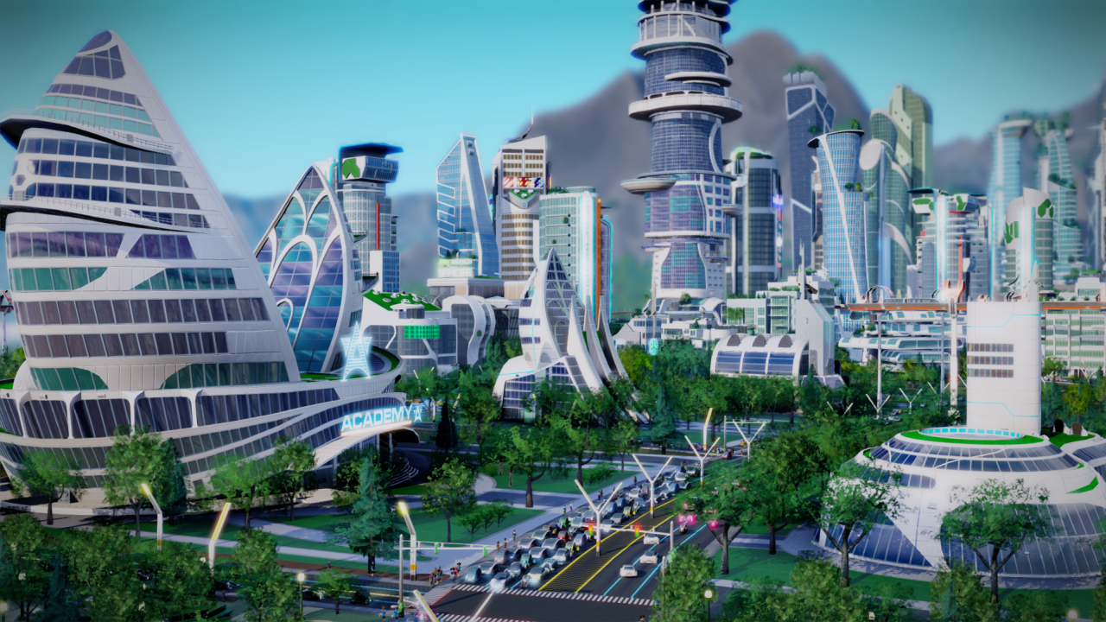

Justin Anderson
Executive Chairman Flexeye
Founder & Director HyperCat
Piers Hogarth Scott
National IoT Leader, KPMG
BUILDING AN interoperable SMART WORLD

Slide 24








WHAT IS HYPERCAT?
Hypercat is an alliance and a standard driving secure and interoperable Internet Things for cities and industry
Hypercat was established 3 years ago in the UK with £15m funding by UK government & industry
Hypercat aims to accelerate market adoption of IoT by creating an interoperable ecosystem to give confidence to the buy side that they can evolve systems and avoid vendor lock in
The Hypercat Alliance aims to create an inclusive one-stop shop of best practice IoT implementation through the sharing of knowledge of processes and application
HyperCat currently has more than 1000 members from industry and the IoT ecosystem

Slide 25


A COLLABORATION BETWEEN STANDARDS DEVELOPMENT ORGANISATIONS
Hypercat is also a standard for interoperability for connected IoT devices
BSI PAS 212 (the Hypercat Specification) with a vision for the Specification to become the global preferred route to data across all sectors of the economy, including cities, infrastructure, health, transport and manufacturing.
The World Wide Web Consortium (W3C) supports Hypercat in complimenting PAS 212 by identifying Industry Specific Use Cases and Requirements for the various IoT pillars in order to transition technical work associated with the Web to an appropriate group in W3C
Standards Australia currently exploring leveraging PAS 212 as an Australian Standard

Slide 26
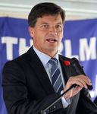
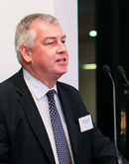
HYPERCAT AUSTRALIA
Hypercat was launched today by the Australian government as an Anglo-Australian collaboration in Smart Cities
“Hypercat Australia will allow a platform to facilitate cutting edge technology solutions to be applied to urban problems. This will be the focus of our recently announced Smart Cities and Suburbs Program.”
Hon Angus Taylor MP, Assistant Minister for Cities and Digital Transformation
“Hypercat was established in the UK with government support to enable Britain to take a lead on smart city investments. We are very pleased to help build on the success of Hypercat by supporting its launch in Australia as an Anglo-Australian collaboration in smart cities and IoT.”
Nick McInnes, British Consul General
Notes:
Standard & Alliance
Unlock smart city investments
Enabler – Accelerate
Local members
Slide showing members
Goto hypercat.io

Slide 27

A COLLABORATION BETWEEN STANDARDS DEVELOPMENT ORGANISATIONS
Convening communities, finding consensus and accelerating market development
Smart infrastructure
Digital health
Connected & autonomous vehicles
Smart cities
Digital manufacturing
BIM Level 3
Smart transport
Bridge building
Platform A
Platform B
Platform C
Platform D
Platform E
Bridging isolated platforms

Slide 28
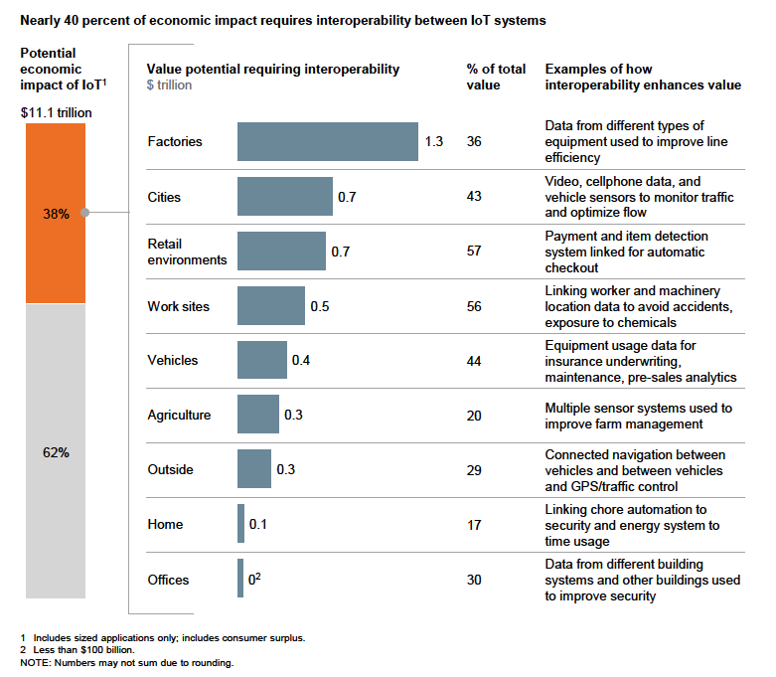
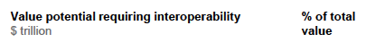
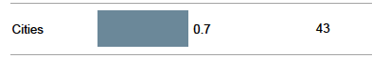
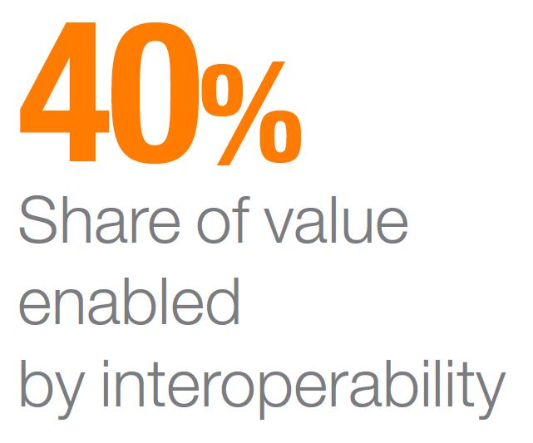
INTEROPERABILITY CORE TO ECONOMIC IMPACT
Source: McKinsey Global Institute Analysis

Slide 29

PAS 212 INTEROPERABILITY STANDARD
Resource Discovery
Common, machine-readable API: HTTPS, REST, JSON
Annotate existing APIs. A simple foundation.
Also
Security, Subscription, Search, Data licenses
Clients (UX and other
services)
Cloud services (Storage, Analytics)
Gateways (devices onto the Internet)
Devices (sensors & actuators in the real world)

Slide 30











HYPERCAT SPEARHEADS
Smart Logistics
Smart Lighting
Smart Parking
Smart
Water
Smart
Buildings
Smart Highways
+
+
Smart Food Safety
Fleet Fault Diagnosis
Smart Facilities
My Guardian
Smart Energy

Slide 31
HYPERCAT VIDEO

Slide 32



EXAMPLE SPEARHEAD PROECT
SPEARHEAD PROJECT: Old Oak & Park Royal

Slide 33
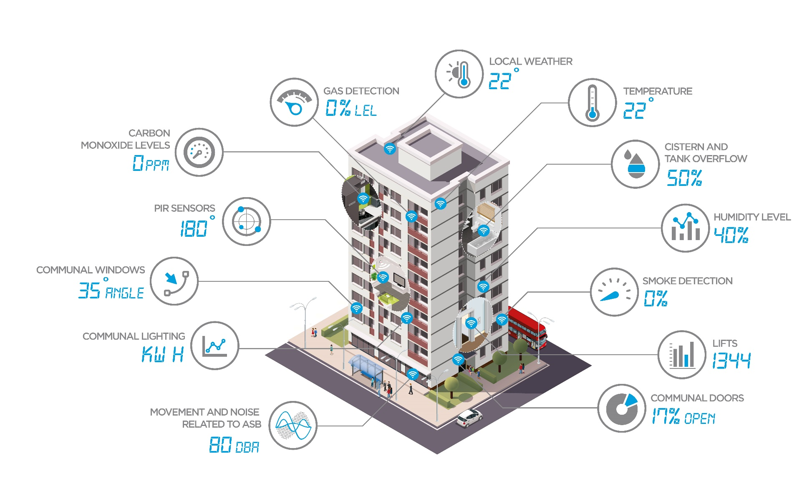
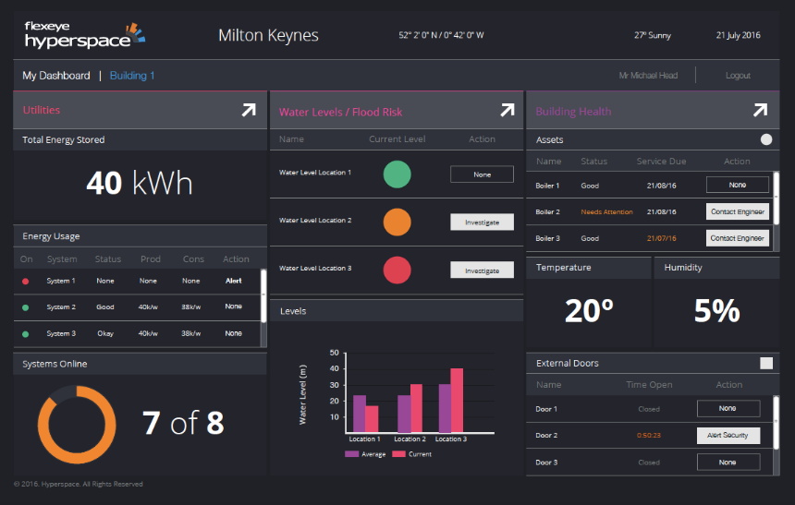
EXAMPLE SPEARHEAD PROECT
SPEARHEAD PROJECT: RIVER CLYDE HOMES, GLASGOW
600 social houses at River Clyde Homes, Glasgow

Slide 34
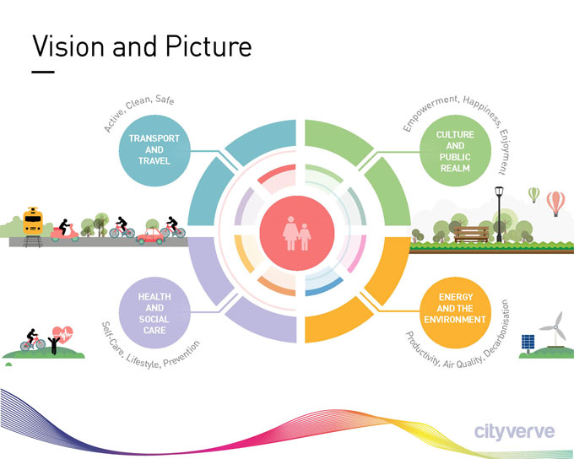
EXAMPLE SPEARHEAD PROECT
MANDATED STANDARD IN GREATER MANCHESTER SMART CITY PROGRAM

Slide 35


HYPERCAT AUSTRALIA – CALL FOR AUSTRALIAN MEMBERS
Hypercat Australia is being established as an independent, not-for-profit organisation and will be administered by the Knowledge Economy Institute led by Dr Mike Briers AO, Australia’s first Industry Professor of IoT at the University of Technology Sydney
Promoting organisation's brand and associated solutions across the Hypercat ecosystem.
Network actively with the Hypercat ecosystem which may open new partner or customer potentials.
Promote and contribute to building the Hypercat use cases across major industries.
To register your interest in joining Hypercat Australia visit:
www.hypercat.io

Slide 36
Thank you

Slide 37
Closing Remarks
Cover design 1
Dr Mike Briers AO UTS

Slide 38
Drinks and Networking
Divider slide

